Slide 1


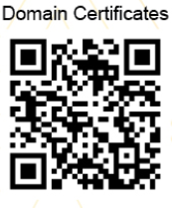

Projects
A.SRINIVAS RAO
DOMAIN SCHOLAR IN DATA SCIENCE BY NPTEL(A JOINT INITIATIVE OF IITs & IISc)

Slide 2





Importance
Real
Company
College
Expectation

Slide 3

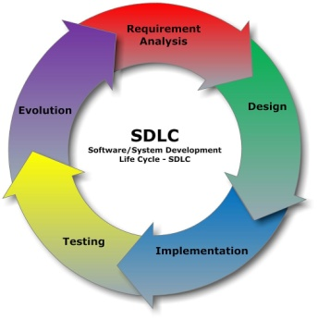






What to do …?
PROJECT

Slide 4


Paper Presentation
Basement…
PROJECT
Software
Engineering (SDLC)
Technical Skills
Documentation
Management
Team Effort

Slide 5


Steps to follow…
Problem Statement
Build Team
Possible Solutions
Project Selection
EDA
Data Collection
Selection of Model
Abstract
Metrics
Project
Try with other models
Submission
Evaluation
Paper Presentation
Conclusion
SDLC
Literature
Software
Advanced Libraries

Slide 6
Google classroom
Ssit_finalcse

Slide 7
Data Set
https://www.kaggle.com/datasets
https://archive.ics.uci.edu/ml/datasets.html

Slide 8
Important Dates
Abstract Submission: 05-04-2021
First Review: 26-04-2021
Second Review: 11-05-2021
Third Review: 07-06-2021
Fourth Review: 06-07-2021
Submission: 31-07-2021

Slide 9

All the Best…

